Slide 1
Mini Project - Data Engineering
4b_Nurul Anggraeni

Slide 2
BUSINESS UNDERSTANDING
Northwind Company adalah Perusahaan yang bergerak dalam bisnis Penyedia makanan dan minuman (food and beverage) di Amerika Serikat. Produk dari Northwind Company adalah Daging/Unggas, bumbu makanan, seafood, produk susu, minuman, sereal, dan makanan manis.
Saat ini Northwind akan melakukan review kinerja penjualan, distribusi dan karyawan pada periode tahun 1996 hingga 1998 untuk menentukan trend kinerja perusahaan dan memberikan “reward” bagi karyawan yang berprestasi dalam kinerja penjualan.
Tim Data Science (DS Team) membantu dalam membuat dashboard yang merepresentasikan trend kinerja penjualan, distribusi, dan karyawan serta membuat rekomendasi untuk kepentingan perusahaan

Slide 3






DATA UNDERSTANDING
Menggunakan dataset prod & shipment Data berisi list penjualan setiap bulan selama 1996-1997. Data juga berisi mengenai demografi pengiriman. Mempunyai 2146 baris dan 8 kolom.
NO |  | Column | Description
1 |  | ProductName | Nama Produk
2 |  | salesorder | Total Penjualan
3 |  | Month | Bulan Penjualan
4 |  | YEAR | Tahun Penjualan
5 |  | Discount | Diskon Harga
6 |  | ShipCountry | Negara Pengiriman

Slide 4


DATA UNDERSTANDING
Menggunakan dataset prod & shipment Data berisi list penjualan setiap bulan selama 1996-1997. Data juga berisi mengenai demografi pengiriman. Mempunyai 2146 baris dan 8 kolom.
NO |  | Column | Description
7 |  | ShipCity | Kota Pengiriman
8 |  | CompanyName | Nama Perusahaan Pelanggan

Slide 5
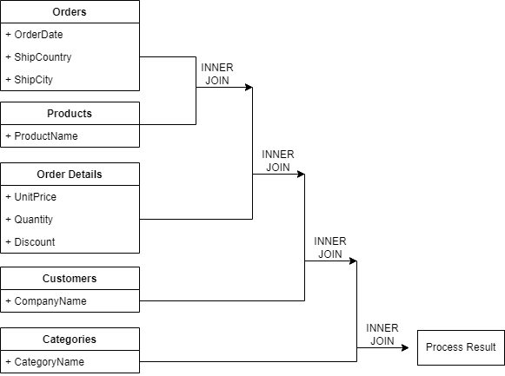
DATA PREPARATION
Data yang digunakan dalam analisa adalah join dari tabel Orders, Products, Order Detail, Customers, dan Categories.
Column yang digunakan:
OrderDate | UnitPrice
ShipCountry | Quantity
ShipCity | Discount
CompanyName | CategoryName
ProductName

Slide 6
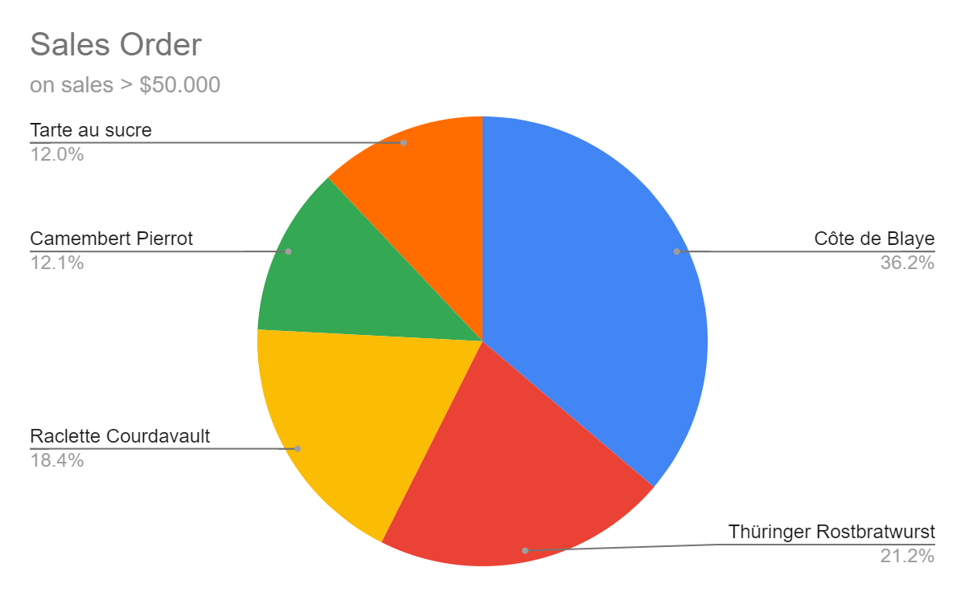
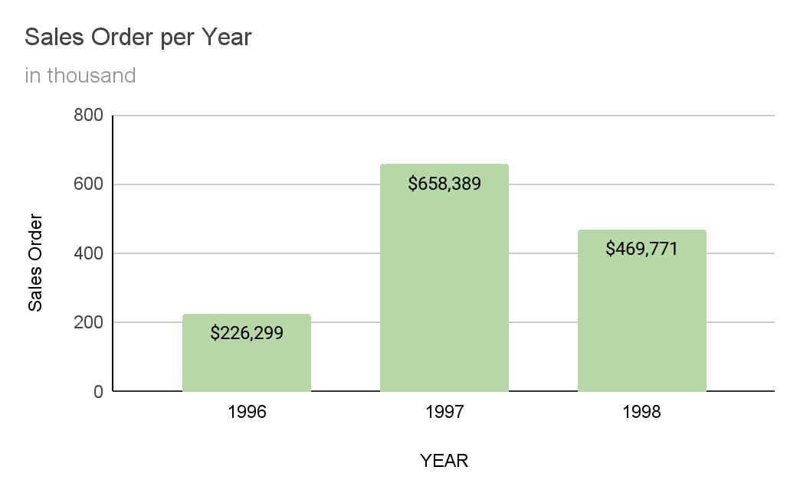
Product Trend

Slide 7
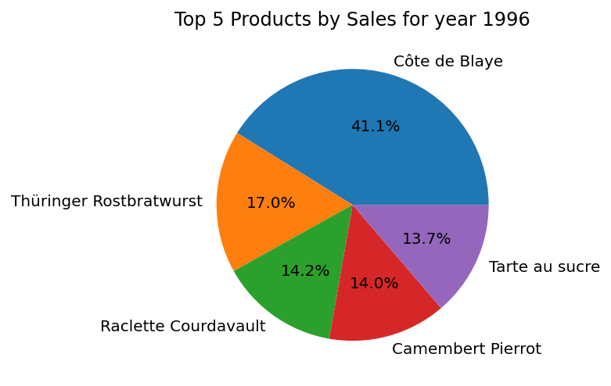
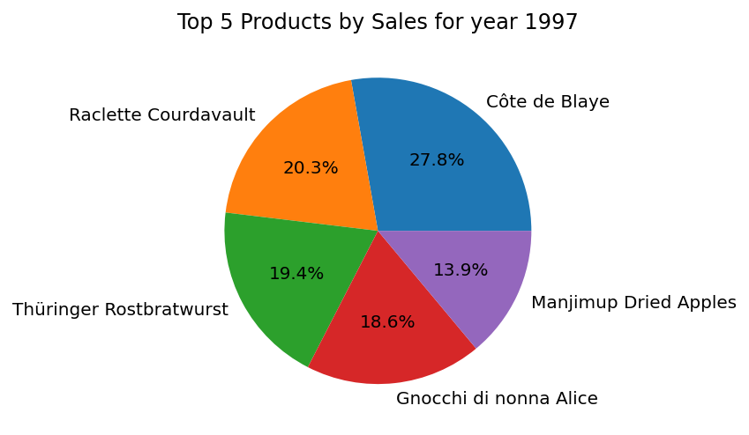
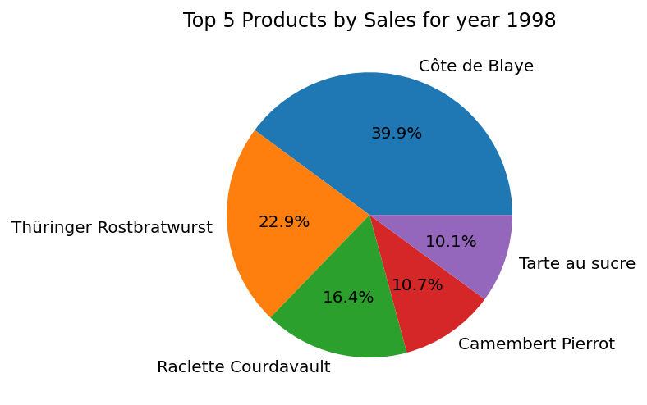
Share of Product Sales by Year

Slide 8
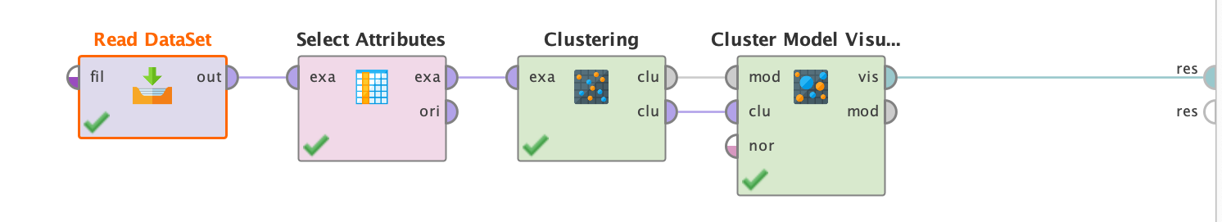
MODELLING
Algoritma yang digunakan untuk clustering adalah k-means dengan library k=modes Cao karena lebih sesuai dengan struktur data kategorikal.
Cluster yang dibentuk sebanyak 8 cluster dengan pertimbangan kategori produk yang dimiliki Northwind saat ini.

Slide 9
CLUSTERING RESULT

Slide 10

Customer in Cluster 0
Shipment to USA
Customer : Save-a-Lot Co.
Boise City
No Discount
± $360 per transaction
Mostly order on March
Recommended Product Promotion: Beverages

Slide 11
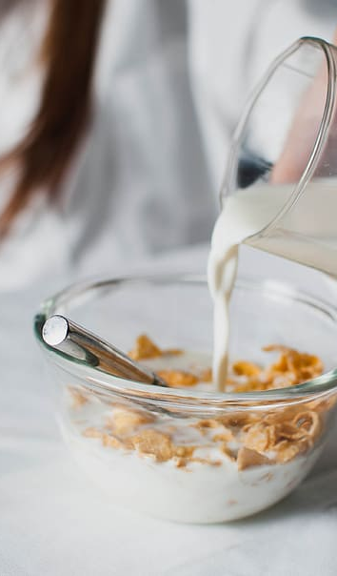
Customer in Cluster 1
Shipment to Germany
Customer : QuickStop Co.
Cunewalde City
No Discount
± $250 per transaction
Mostly order on April
Recommended Product Promotion: Dairy Product

Slide 12

Customer in Cluster 2
Shipment to Austria
Customer : Ernst Handel
Graz City
No Discount
± $300 per transaction
Mostly order on January
Recommended Product Promotion: Confections (Gula-Gula)

Slide 13
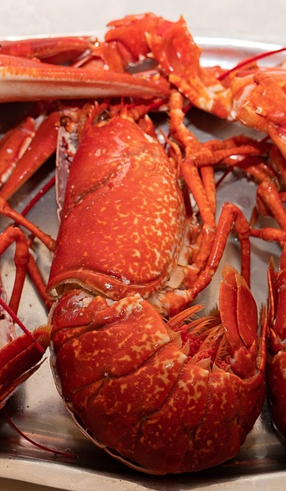
Customer in Cluster 3
Shipment to Brazil
Customer : Berglunds Co
Rio De Janeiro City
No Discount
± $360 per transaction
Mostly order on Feb
Recommended Product Promotion: Seafood

Slide 14
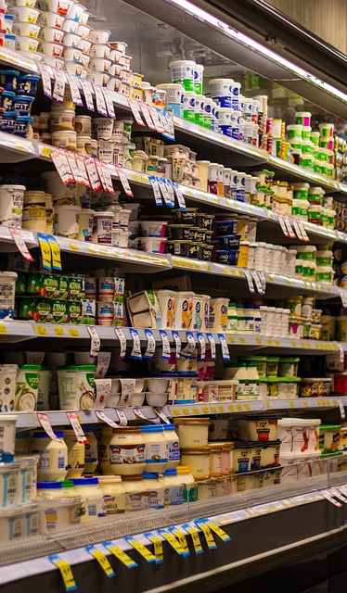
Customer in Cluster 4
Shipment to USA
Customer : Rattlesnake
Albuquerque City
No Discount
± $360 per transaction
Mostly order on January
Recommended Product Promotion: Dairy Products

Slide 15

Customer in Cluster 5
Shipment to Germany
Customer : Frankenversand
Munchen City
No Discount
± $360 per transaction
Mostly order on January
Recommended Product Promotion: Beverages

Slide 16
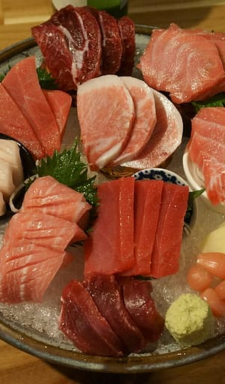
Customer in Cluster 6
Shipment to USA
Customer : Hungry Owl Co
Seattle City
No Discount
± $570 per transaction
Mostly order on April
Recommended Product Promotion: Seafood

Slide 17
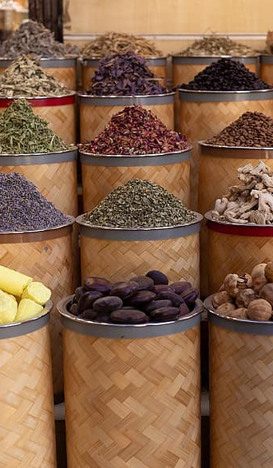
Customer in Cluster 7
Shipment to France
Customer : Bon App’
Marseille City
No Discount
± $380 per transaction
Mostly order on December
Recommended Product Promotion: Condiments

Slide 18
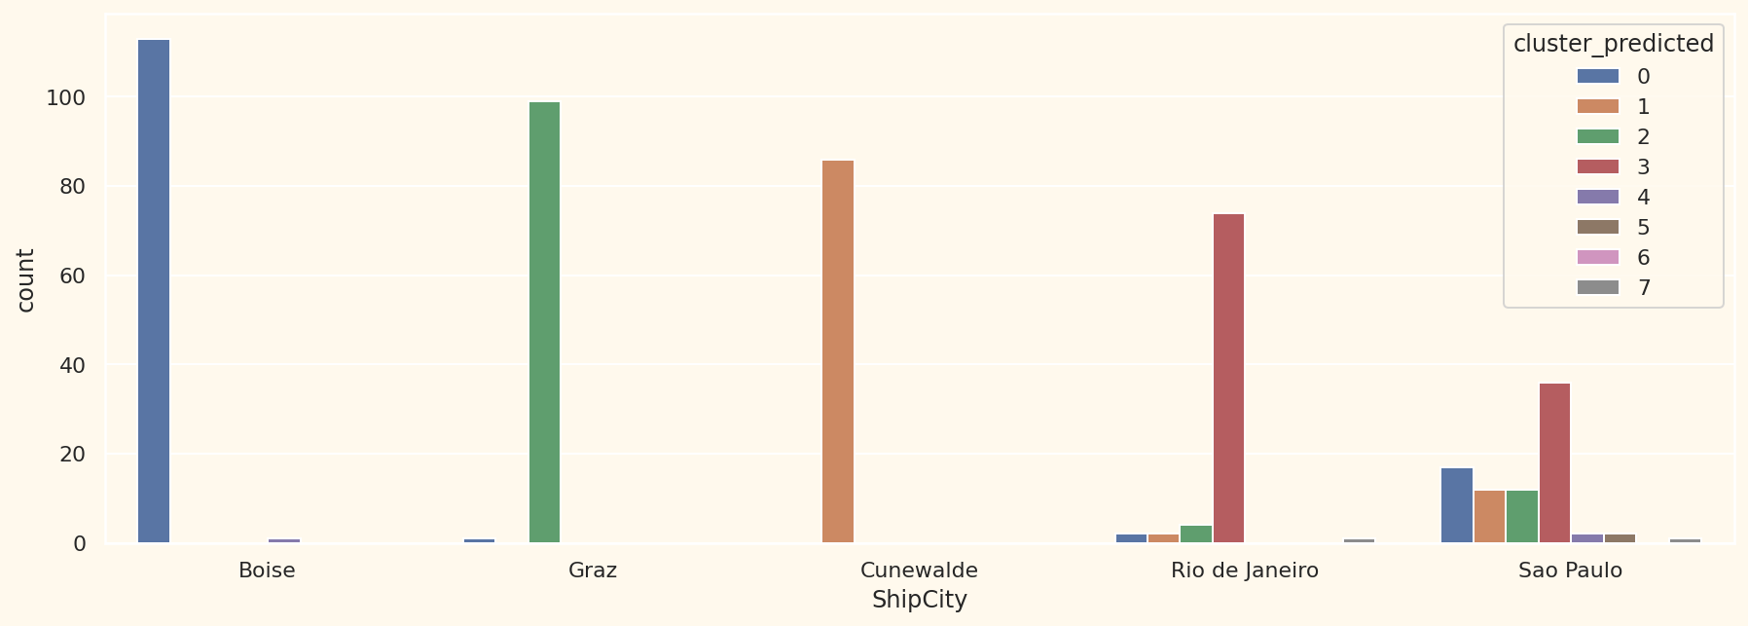
Shipment City

Slide 19
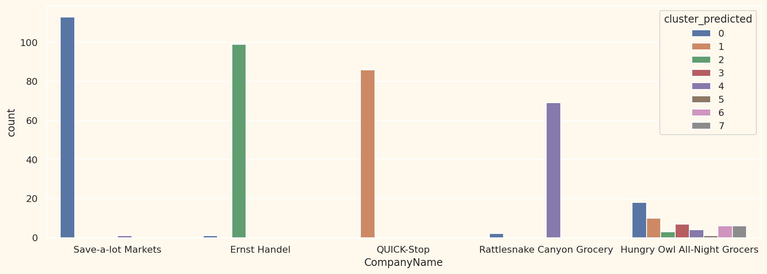
Company Name

Slide 20
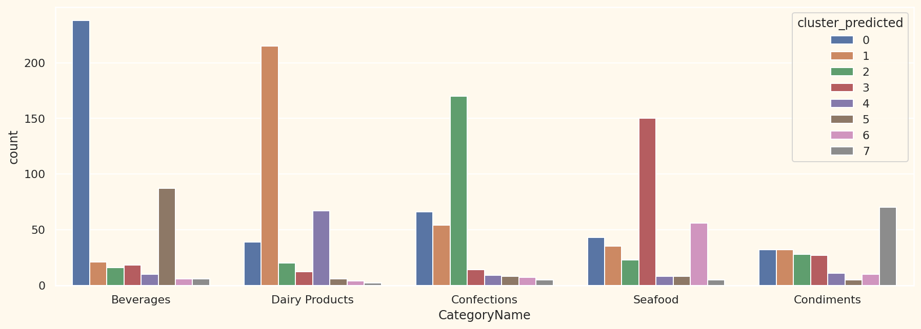
Product Category

Slide 21
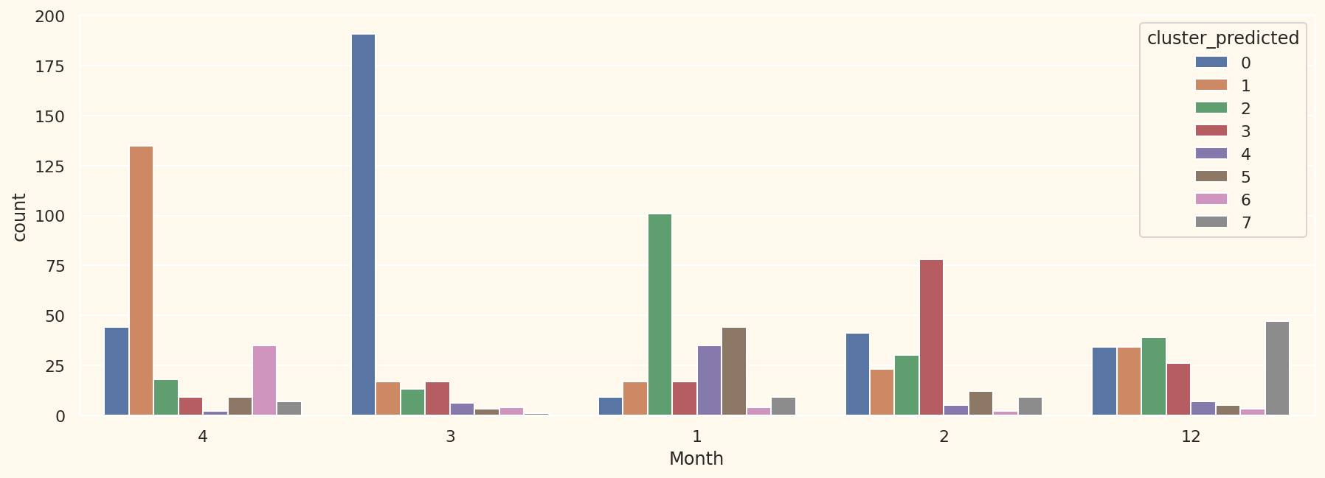
Sales Month

Slide 22
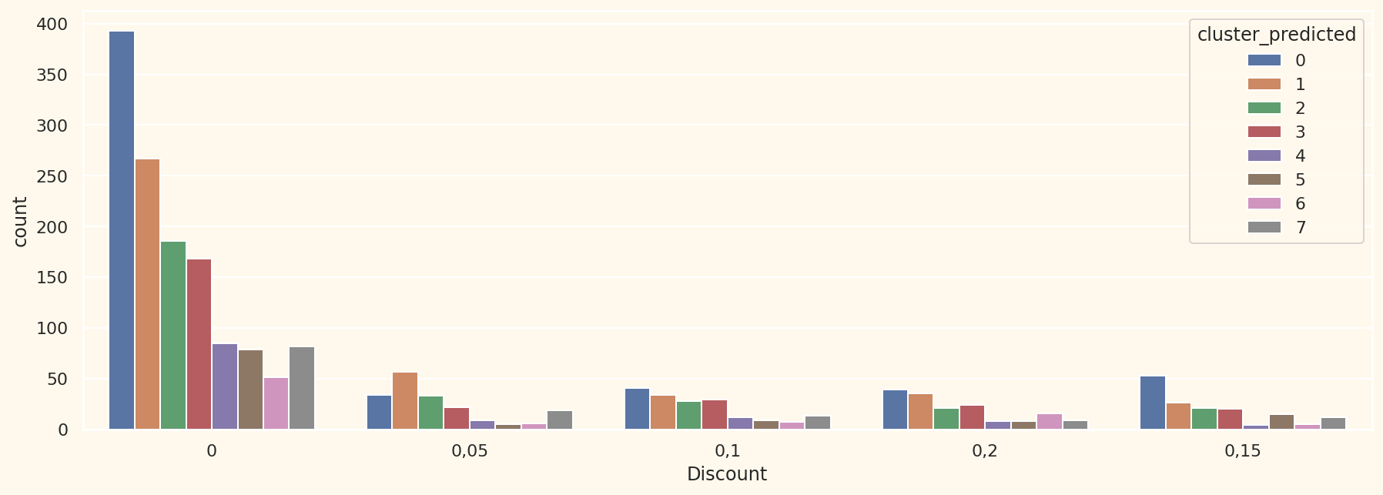
Discount

Slide 23
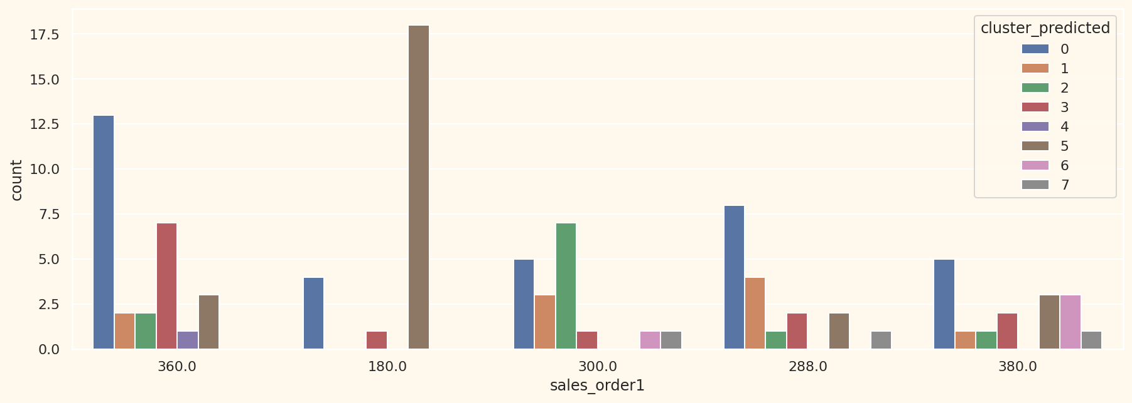
Sales on single transaction

Slide 24
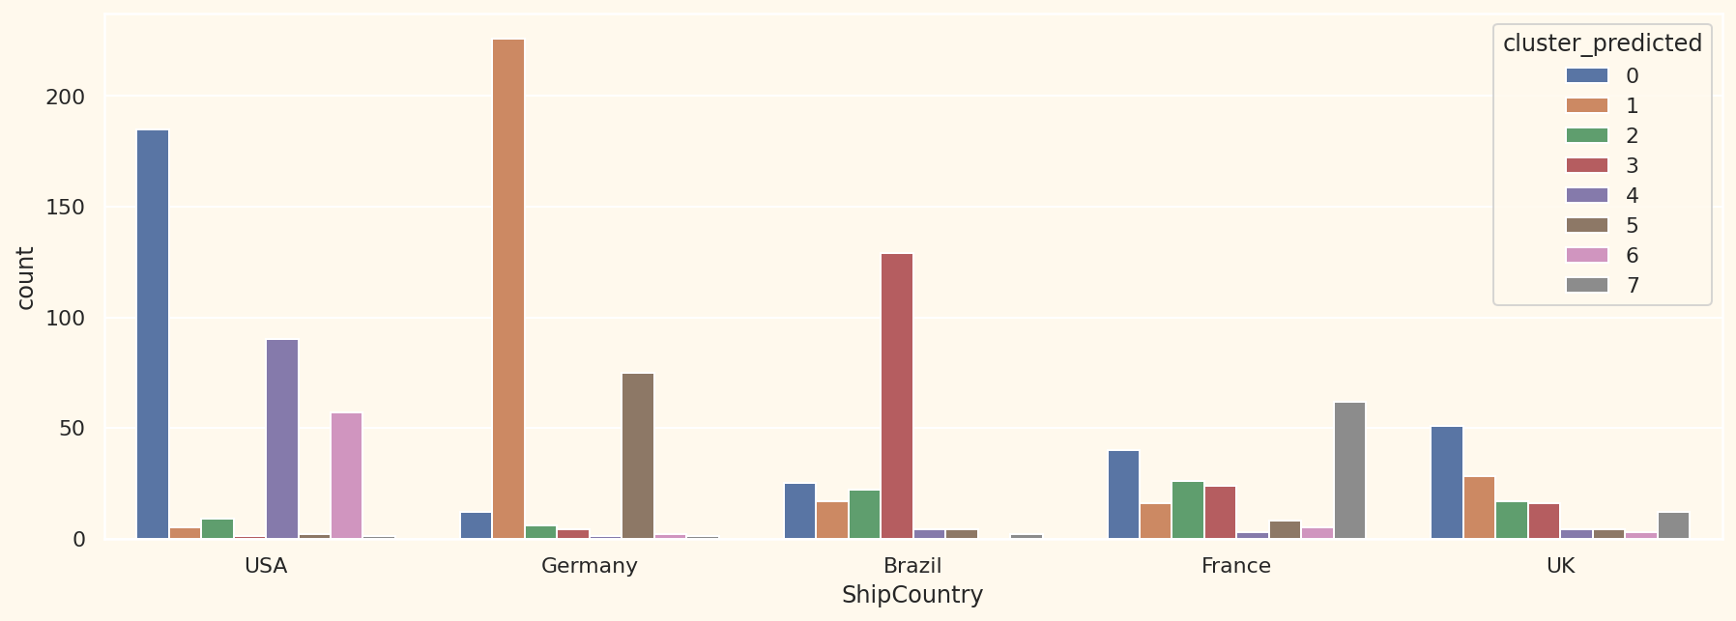
Country

Slide 25
EMPLOYEE PERFORMANCE ANALYSIS

Slide 26
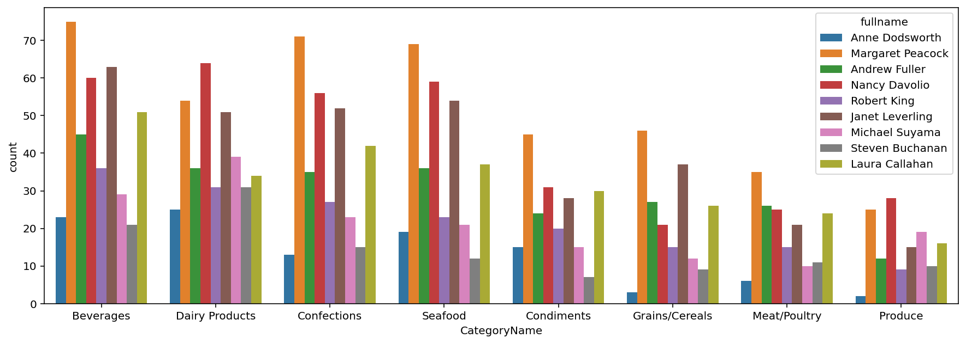
Sales Performance based on Product Category

Slide 27
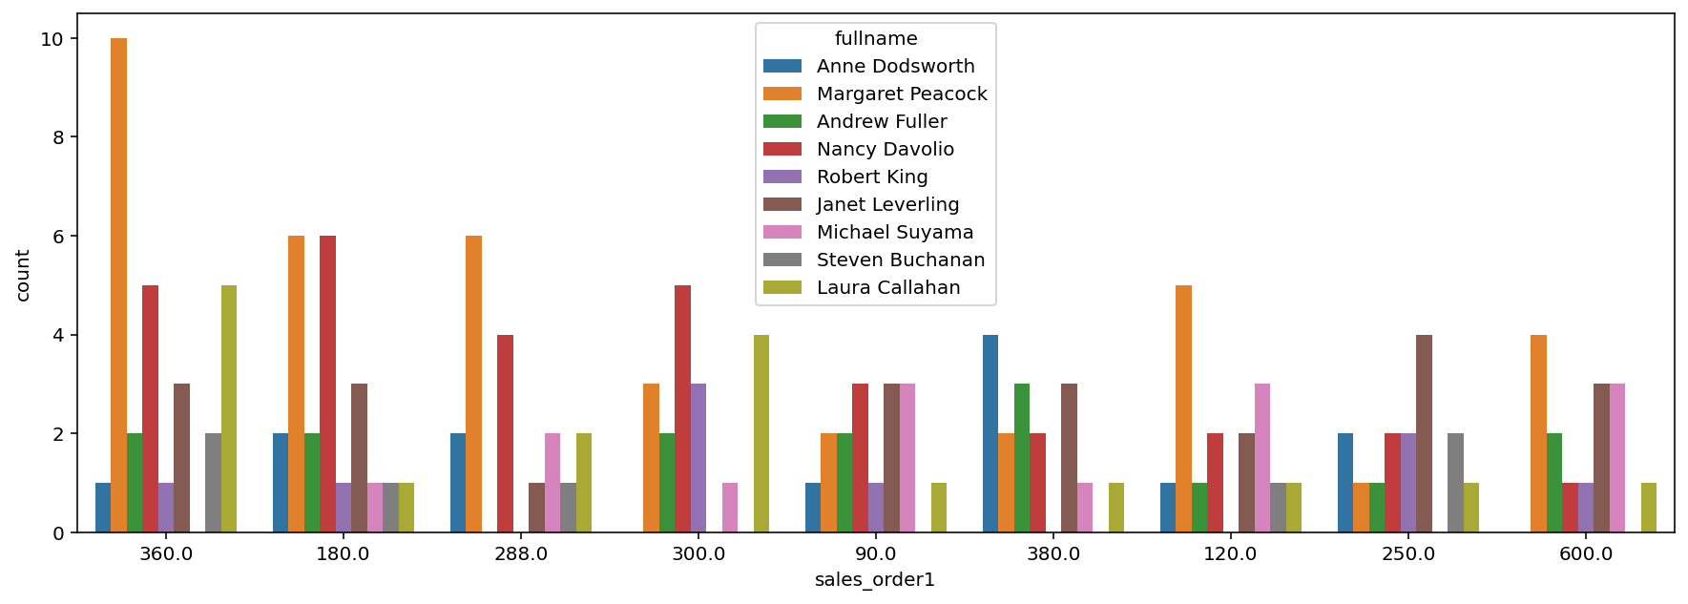
Sales Performance based on Single Amt Transaction

